Slide 1




E-Waste Tracking and Management
TG08003219
Author 1
Photo
Author 2
Photo
Author 3
Photo
Author 4
Photo
Deepika T R
Deepthi K
Nishanth K J
Skanda P M
Maharaja Institute of Technology Mysore
Mysore
Dr. Victor Ikechukwu Agughasi

Slide 2
Challenge Statement
Electronic waste (E-waste) is a rapidly growing global issue due to the increasing pace of technological advancements and consumerism[1]. [2].
Improper disposal of e-waste poses significant risks to the environment and public health, as valuable materials are wasted, and hazardous substances are released[3].
Despite existing efforts, only a fraction of e-waste is effectively collected, tracked, and recycled.
The challenge is to develop an innovative, scalable, and transparent e-waste tracking and management solution that ensures efficient collection, segregation, and recycling while addressing critical factors such as data privacy, user engagement, and real-time monitoring[4].

Slide 3
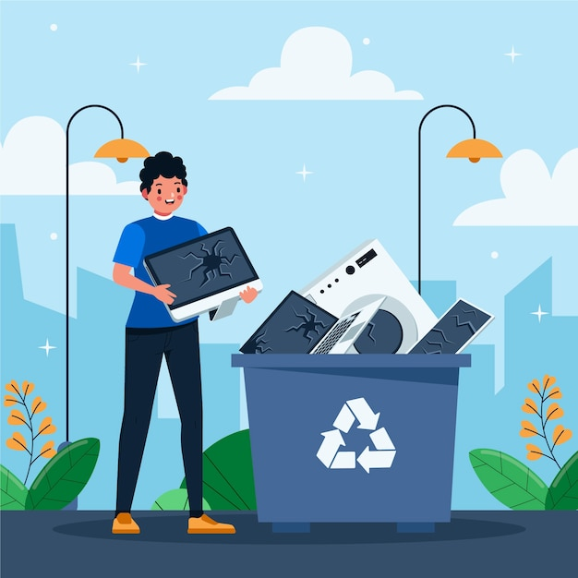
Concept / Solution - 1
Concept:
The E-Waste Tracking and Management System addresses the growing challenge of electronic waste (e-waste) through an innovative, technology-driven approach.
It integrates real-time monitoring, user engagement, and data analytics to manage e-waste effectively from its generation to final disposal[5].
The system promotes transparency, user trust, and sustainability by leveraging advanced technologies and collaboration with certified recycling vendors.

Slide 4
Concept / Solution - 2
Solution:
QR Code Integration: Each device is assigned a unique QR code during manufacturing, containing details like material composition, lifecycle, and disposal guidelines.
Mobile App Interaction: Consumers use the E-Waste Manager App to scan the QR code, locate nearby drop-off points, or schedule pickups with certified recyclers.
Recycling and Tracking: At recycling centres, the QR code is scanned into a blockchain system, ensuring transparent tracking of dismantling and material reuse processes[6].
Reward System: Users earn eco-points for recycling, redeemable for discounts on eco-friendly products, motivating responsible disposal behaviour.
Improvements:
Standardized QR Codes for universal use.
Smart Contracts to automate rewards.
Gamification to encourage participation.
Government Dashboards to monitor recycling rates and policies.

Slide 5
Pros and Cons of the solution
Pros
Transparency: Blockchain ensures tamper-proof tracking.
User Engagement: Rewards and gamification motivate recycling.
Efficiency: AI automates waste segregation and collection logistics.
Sustainability: Promotes a circular economy by reusing materials.
Scalability: Mobile platforms and cloud infrastructure enable widespread adoption.
Cons
High Costs: Blockchain and AI implementation require significant investment.
Complexity: Integrating multiple technologies can be challenging.
Adoption Barriers: Users may be reluctant due to lack of awareness.
Privacy Concerns: Data tracking may raise security issues.
Dependency: Success relies on availability of certified recyclers.

Slide 6
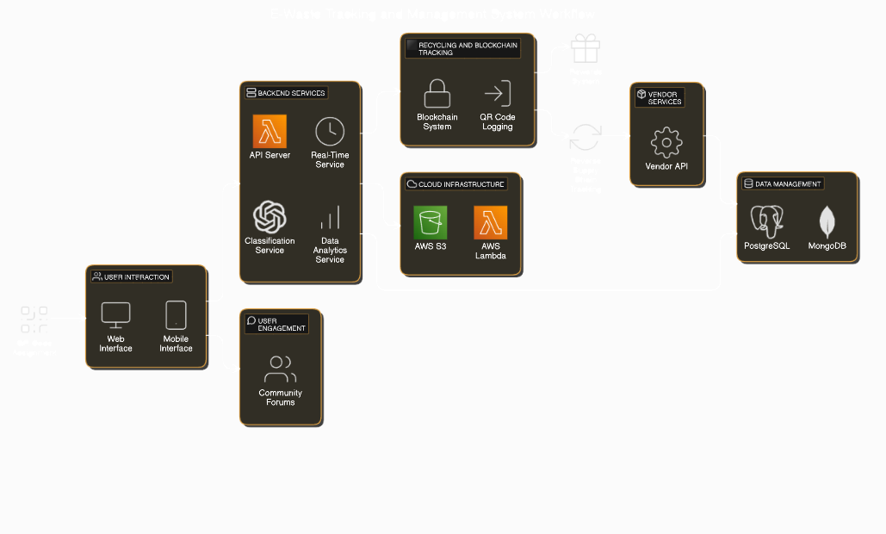
Technical Description
QR Code Assignment: Devices are tagged with QR codes at manufacturing, storing details like materials and lifecycle.
User Interaction: Users use the web/mobile app to scan QR codes, locate drop-off points, or schedule pickups.
Backend Services:
API Server connects users, blockchain, and databases.
AI Services classify e-waste and analyse recycling trends.
Recycling and Blockchain Tracking:
QR codes are logged in the blockchain, ensuring transparency in recycling steps.
Cloud Infrastructure: AWS S3 and Lambda handle data storage and processing.
Vendor Services: Recyclers log metrics like material purity via integrated APIs.
Data Management: PostgreSQL and MongoDB store structured and unstructured data.
Reward System Integration:
Implements a smart contract system for automating reward distribution, ensuring accurate eco-point allocation for users.

Slide 7
Technical Description-Summary
Component | Technology & Purpose
Frontend | React.js : Dynamic UI for web applications.
Mobile App | React Native: Cross-platform mobile app.
Backend | Node.js (Express) / Django: Scalable backend for requests and APIs.
Database | PostgreSQL / MongoDB: Data storage for structured and unstructured data.
Blockchain | Ethereum / Hyperledger: Transparency and traceability with smart contracts.
Cloud | AWS / Google Cloud: Scalable cloud storage and computing.
Real-Time | Firebase / WebSocket: Real-time notifications.
AI & ML | TensorFlow / PyTorch: AI for classification and optimization.

Slide 8
Implementation Plan
Phase 1: Planning and Design
Define project scope, goals, and deliverables.
Create system architecture and wireframes for the app and website.
Choose tools and technologies (React.js, Node.js/Django, MongoDB, Blockchain).
Phase 2: Development
Frontend Development: Build user-friendly mobile and web interfaces.
Backend Development: Implement APIs for QR code generation, user authentication, and recycling tracking.
Blockchain Setup: Configure a basic blockchain for tracking e-waste recycling processes.
Database Management: Set up PostgreSQL/MongoDB for storing user and recycling data.
Phase 3: Integration and Testing
Integrate the frontend, backend, and blockchain components.
Test for functionality, security, and scalability using tools like Postman and Selenium.

Slide 9
Implementation Plan
Phase 4: Launch
Deploy the system on free-tier cloud hosting (AWS, Heroku, or Vercel).
Release the mobile app on Android (Play Store) initially for wide accessibility.
Phase 5: User Engagement and Scaling
Launch marketing campaigns to drive user adoption.
Partner with local recycling vendors for operational support.
Monitor system usage and scale resources as needed.
Phase 6: Maintenance and Updates
Regularly update the app and system based on user feedback.
Add advanced features like AI-based classification and smart contracts for automation.

Slide 10
Validation / Testing / Analysis
Unit Testing: Test individual components (AI, blockchain) for correct functionality.
Integration Testing: Ensure smooth interaction between frontend, backend, and cloud systems.
Model Evaluation: Measure AI model accuracy (precision, recall, F1-score) for waste classification.
End-to-End Testing: Simulate the full data flow from e-waste collection to recycling.
User Testing: Validate ease of use and performance with real users.
Performance Testing: Stress-test system for scalability and response time under load.
Security Testing: Assess data privacy, blockchain security, and overall system vulnerability.
Continuous Monitoring: Monitor system performance post-deployment and improve based on feedback[7].

Slide 11
Cost Estimate
Item | Tool/Service | Estimated Cost (₹)
Frontend Development | Free tools like React.js | 0
Backend Development | Free tools like Node.js/Django | 0
Cloud Hosting | Free tiers: Heroku, AWS, Vercel | 2,000/year
Blockchain Integration | Free frameworks: Hyperledger | 0
Database Management | MongoDB Atlas Free Tier or PostgreSQL | 2,000/year
Testing & Quality Assurance | Tools like Postman, Selenium | 0
Domain Name | Affordable providers like Namecheap | 500 - 1,000/year
Server Costs (after free tier) | Minimal hosting fees after free tier | 1,000 - 3,000/year
Maintenance | Self-maintained | 0

Slide 12
Assumptions
Assumptions
Users will engage due to incentives like eco-points.
Free tools (React.js, Node.js, MongoDB) and free-tier hosting will suffice initially.
Blockchain implementation will remain basic.
Local recyclers will participate in the system.
Maintenance costs will be minimal.
Predicted Outcomes
Increased recycling rates and reduced e-waste in landfills.
Transparent tracking builds user trust.
Sustainable user engagement via rewards and gamification.
Cost-effective scalability supports future growth.

Slide 13
How the System Works
QR Code Assignment:
Each device gets a unique QR code at manufacturing, storing details like materials, serial number, and disposal guidelines.
User Interaction:
When the device reaches end-of-life, users scan the QR code using the app to find nearby drop-off points or schedule a pickup.
Recycling Process:
At the recycling centre, the QR code is scanned, and the device's recycling journey is tracked via blockchain, ensuring transparency.
Rewards:
Users earn eco-points for recycling, redeemable for discounts on eco-friendly products or services.
Example:
John recycles his smartphone, tracks its process on the app, and redeems 50 points for a ₹100 discount on an eco-friendly product.

Slide 14
References
[1] S. Goyal and S. Gupta, “A comprehensive review of current techniques, issues, and technological advancements in sustainable E-waste management,” e-Prime - Advances in Electrical Engineering, Electronics and Energy, vol. 9, p. 100702, Sep. 2024, doi: 10.1016/j.prime.2024.100702.
[2] S. o. Maitanmi and T. Fagbe, “Green computing: the growing concern on information management, e-waste, safety, health and environment,” International Journal of Business Information Systems, vol. 47, no. 1, pp. 73–90, Jan. 2024, doi: 10.1504/IJBIS.2024.142191.
[3] S. Artang, I. A. Hameed, and A. Ghasemian, “E-Waste Tracker: A Platform To Monitor E-Waste From Collection To Recycling,” in ECMS 2023 Proceedings edited by Enrico Vicario, Romeo Bandinelli, Virginia Fani, Michele Mastroianni, ECMS, Jun. 2023, pp. 487–494. doi: 10.7148/2023-0487.
[4] A. U. R. Khan and R. W. Ahmad, “A Blockchain-Based IoT-Enabled E-Waste Tracking and Tracing System for Smart Cities,” IEEE Access, vol. 10, pp. 86256–86269, 2022, doi: 10.1109/ACCESS.2022.3198973.
[5] A. M. O. Mohamed, “Enhancing radioactive waste management with cutting-edge digital technologies: a review,” Academia Engineering, vol. 1, no. 4, Oct. 2024, Accessed: Dec. 02, 2024. [Online]. Available: https://www.academia.edu/2994-7065/1/4/10.20935/AcadEng7385
[6] “Management of Computer and Electronic Waste through the Fifth Industrial Revolution for the Cleaner Environment | IEEE Conference Publication | IEEE Xplore.” Accessed: Dec. 02, 2024. [Online]. Available: https://ieeexplore.ieee.org/abstract/document/10629821
[7] K. Geetha, J. Vigneshwari, P. Bhambri, and A. Thangam, “Sustainable Solutions for Global Waste Challenges: Integrating Technology in Disposal and Treatment Methods,” in Handbook of Technological Sustainability, CRC Press, 2024.

Slide 15




